Slide 1
Software Testing and Quality Assurance
Theory and Practice
Chapter 9
Functional Testing
Notes:
Handouts
------------------------------------------------------------------
------------------------------------------------------------------
-------------------------------------------------------------------
--------------------------------------------------------------------

Slide 2
Outline of the Chapter
Functional Testing Concepts of Howden
Different Types of Variables
Test Vectors
Howden’s Functional Testing Summary
Pairwise Testing
Orthogonal Array
In Parameter Order
Equivalence Class Partitioning
Guidelines for Equivalence Class Partitioning
Identification of Test Cases
Advantages of Equivalence Class Partitioning
Boundary Value Analysis (BVA)
Guidelines for Boundary Value Analysis
Decision Tables
Random Testing
Adaptive Random Testing
Error Guessing
Category Partition
Notes:
Handouts

Slide 3
Functional Testing Concepts of Howden
The four key concepts in functional testing are:
Precisely identify the domain of each input and each output variable
Select values from the data domain of each variable having important properties
Consider combinations of special values from different input domains to design test cases
Consider input values such that the program under test produces special values from the domains of the output variables
Notes:
Handouts

Slide 4
Different Types of Variables
Numeric Variables
  A set of discrete values
  A few contiguous segments of values
Arrays
  An array holds values of the same type, such as integer and real. Individual elements of an array are accessed by using one or more indices.
Substructures
  A structure means a data type that can hold multiple data elements. In the field of numerical analysis, matrix structure is commonly used.
Subroutine Arguments
  Some programs accept input variables whose values are the names of functions. Such programs are found in numerical analysis and statistical applications
Notes:
Handouts

Slide 5
Test Vectors
A test vector is an instance of an input to a program, a.k.a. test data
If a program has n input variables, each of which can take on k special values, then there are k^{n} possible combinations of test vectors
We have more than one million test vectors even for k = 3 and n = 20
There is a need to identify a method for reducing the number of test vectors
Howden suggested that there is no need of combining values of all input variables to design a test vector, if the variables are not functionally related
It is difficult to give a formal definition of the idea of functionally related variables, but it is easy to identify them
  Variables appearing in the same assignment statement are functionally related
  Variables appearing in the same branch predicate – the condition part of an if statement, for example – are functionally related
Notes:
Handouts

Slide 6
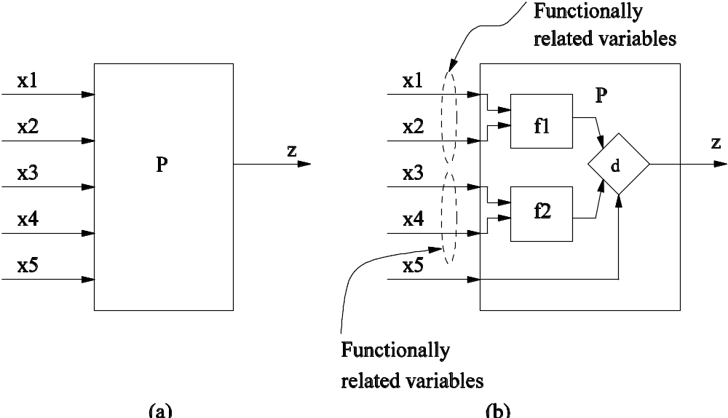
Test Vectors
Example of functionality related variables
Figure 9.3: Functionality related variables
Notes:
Handouts

Slide 7
Howden’s Functional Testing Summary
Let us summarize the main points in functional testing:
Identify the input and the output variables of the program and their data domains
Compute the expected outcomes as illustrated in Figure 9.5(a), for selected input values
Determine the input values that will cause the program to produce selected outputs as illustrated in Figure 9.5(b).
Notes:
Handouts

Slide 8
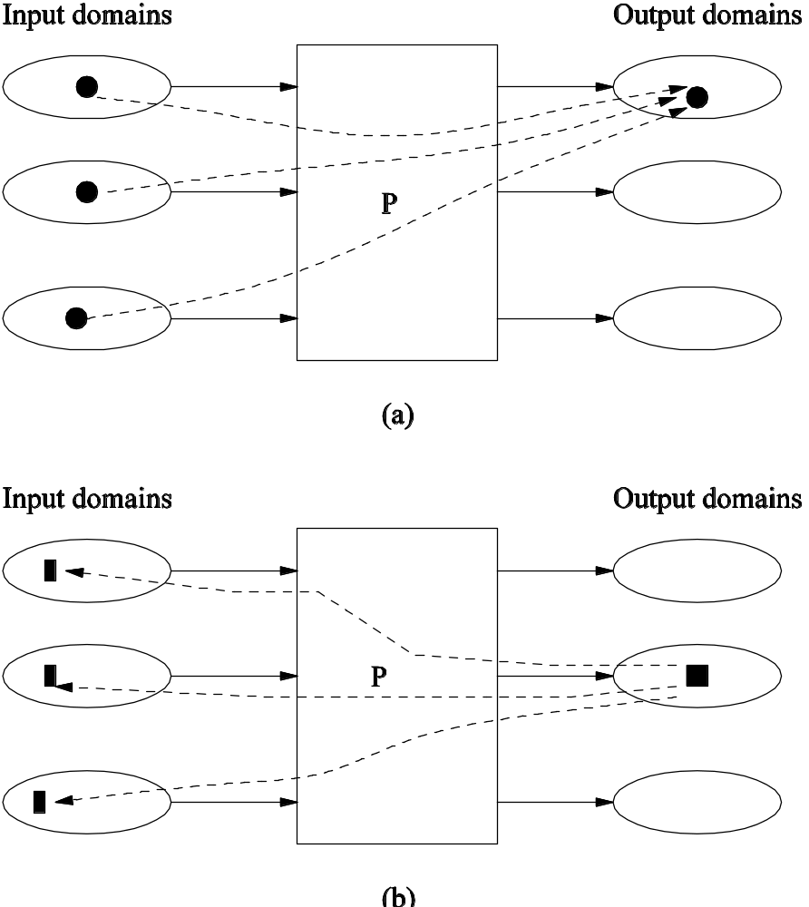
Howden’s Functional Testing Summary
Figure 9.5: Obtaining output values from an input vector (a), and obtaining an input vector from an output value (b) in functional testing
Notes:
Handouts

Slide 9
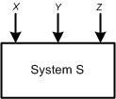
Pairwise Testing
Pairwise testing means that each possible combination of values for every pair of input variables is covered by at least one test case
Consider the system S in Figure 9.7, which has three input variables X, Y, and Z.
For the three given variables X, Y , and Z, their value sets are as follows: D(X) = {True, False}, D(Y ) = {0, 5}, and D(Z) = {Q,R}
Figure 9.7: System S with three input variables.
Notes:
Handouts

Slide 10
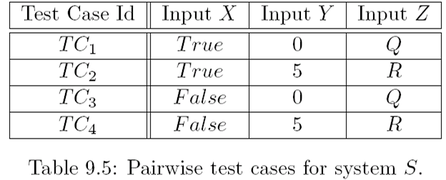
Pairwise Testing
The total number of all-combination test cases is 2 × 2 × 2 = 8
However, a subset of four test cases, as shown in Table 9.5, covers all pairwise combinations
Notes:
Handouts

Slide 11
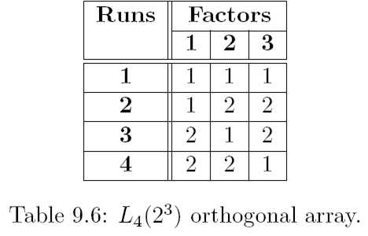
Orthogonal Array
Consider the two-dimensional array of integers shown in Table 9.6
This is an example of L₄(2³) orthogonal array
The “4” indicates that the array has 4 rows, also known as runs
The “2³” part indicates that the array has 3 columns, known as factors, and each cell in the array contains 2 different values, known as levels.
Levels mean the maximum number of values that a single factor can take on
Orthogonal arrays are generally denoted by the pattern L_{Runs}(Levels^{Factors})
Notes:
Handouts

Slide 12
Orthogonal Array
Let us consider our previous example of the system S.
The system S which has three input variables X, Y, and Z.
For the three given variables X, Y , and Z, their value sets are as follows: D(X) = {True, False}, D(Y ) = {0, 5}, and D(Z) = {Q,R}.
Map the variables to the factors and values to the levels onto the L₄(2³) orthogonal array (Table 9.6) with the resultant in Table 9.5.
In the first column, let 1 = True, 2 = False.
In the second column, let 1 = 0, 2 = 5.
In the third column, let 1 = Q, 2 = R.
Note that, not all combinations of all variables have been selected
Instead combinations of all pairs of input variables have been covered with four test cases
Notes:
Handouts

Slide 13
Orthogonal Array
Orthogonal arrays provide a technique for selecting a subset of test cases with the following properties:
  It guarantees testing the pairwise combinations of all the selected variables
  It generates fewer test cases than a all-combination approach.
  It generates a test suite that has even distribution of all pairwise combinations
  It can be automated
Notes:
Handouts

Slide 14
In Parameter Order
Tai and Lei have given an algorithm called In Parameter Order (IPO) to generate a test suite for pairwise coverage of input variables
The algorithm runs in three phases, namely, initialization, horizontal growth, and vertical growth, in that order
In the initialization phase, test cases are generated to cover two input variables
In the horizontal growth phase, the existing test cases are extended with the values of the other input variables.
In the vertical growth phase, additional test cases are created such that the test suite satisfies pairwiae coverage for the values of the new variables.
Notes:
Handouts

Slide 15
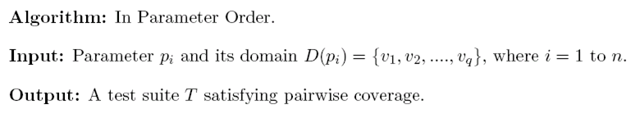
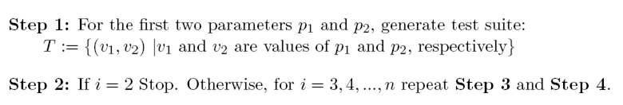
In Parameter Order
Initialization
Notes:
Handouts

Slide 16
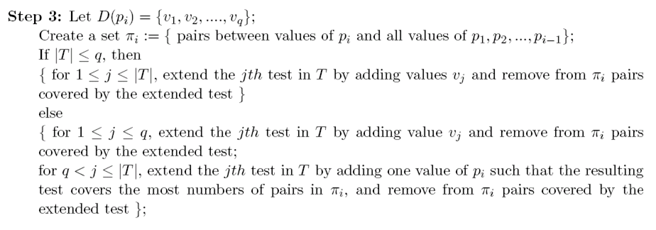
In Parameter Order
Horizontal Growth Phase
Notes:
Handouts

Slide 17
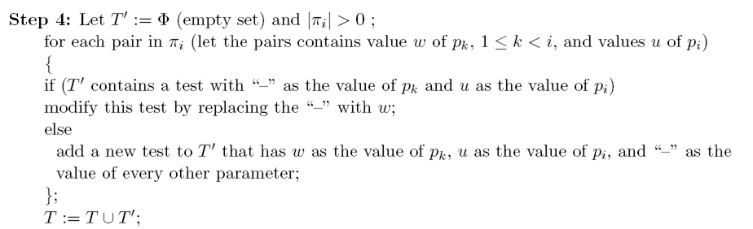
In Parameter Order
Vertical Growth Phase
Notes:
Handouts

Slide 18
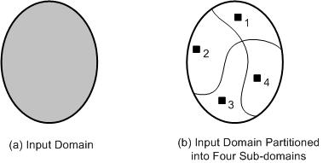
Equivalence Class Partitioning
An input domain may be too large for all its elements to be used as test input (Figure 9.8(a))
The input domain is partitioned into a finite number of subdomains
Each subdomain is known as an equivalence class, and it serves as a source of at least one test input (Figure 9.8(b))
A valid input to a system is an element of the input domain that is expected to return a non error value
An invalid input is an input that is expected to return an error value.
Figure 9.8: (a) Too many test input; (b) One input is selected from each of the subdomain
Notes:
Handouts

Slide 19
Guidelines for Equivalence Class Partitioning
An input condition specifies a range [a, b]
  one equivalence class for a < X < b, and
  two other classes for X < a and X > b to test the system with invalid inputs
An input condition specifies a set of values
  one equivalence class for each element of the set {M₁}, {M₂}, ...., {M_{N}}, and
  one equivalence class for elements outside the set {M₁,M₂, ...,M_{N}}
Input condition specifies for each individual value
  If the system handles each valid input differently then create one equivalence class for each valid input
An input condition specifies the number of valid values (Say N)
  Create one equivalence class for the correct number of inputs
  two equivalence classes for invalid inputs – one for zero values and one for more than N values
An input condition specifies a “must be” value
  Create one equivalence class for a “must be” value, and
  one equivalence class for something that is not a “must be” value
Notes:
Handouts

Slide 20
Identification of Test Cases
Test cases for each equivalence class can be identified by:
Assign a unique number to each equivalence class
For each equivalence class with valid input that has not been covered by test cases yet, write a new test case covering as many uncovered equivalence classes as possible
For each equivalence class with invalid input that has not been covered by test cases, write a new test case that covers one and only one of the uncovered equivalence classes
Notes:
Handouts

Slide 21
Advantages of Equivalence Class Partitioning
A small number of test cases are needed to adequately cover a large input domain
One gets a better idea about the input domain being covered with the selected test cases
The probability of uncovering defects with the selected test cases based on equivalence class partitioning is higher than that with a randomly chosen test suite of the same size
The equivalence class partitioning approach is not restricted to input conditions alone – the technique may also be used for output domains
Notes:
Handouts

Slide 22
Boundary Value Analysis (BVA)
The central idea in Boundary Value Analysis (BVA) is to select test data near the boundary of a data domain so that data both within and outside an equivalence class are selected
The BVA technique is an extension and refinement of the equivalence class partitioning technique
In the BVA technique, the boundary conditions for each of the equivalence class are analyzed in order generate test cases
Notes:
Handouts

Slide 23
Guidelines for Boundary Value Analysis
The equivalence class specifies a range
  If an equivalence class specifies a range of values, then construct test cases by considering the boundary points of the range and points just beyond the boundaries of the range
The equivalence class specifies a number of values
  If an equivalence class specifies a number of values, then construct test cases for the minimum and the maximum value of the number
  In addition, select a value smaller than the minimum and a value larger than the maximum value.
The equivalence class specifies an ordered set
  If the equivalence class specifies an ordered set, such as a linear list, table, or a sequential file, then focus attention on the first and last elements of the set.
Notes:
Handouts

Slide 24
Decision Tables
The structure of a decision table has been shown in Table 9.13
It comprises a set of conditions (or, causes) and a set of effects (or, results) arranged in the form of a column on the left of the table
In the second column, next to each condition, we have its possible values: Yes (Y), No (N), and Don’t Care (“-”)
To the right of the “Values” column, we have a set of rules. For each combination of the three conditions {C1,C2,C3}, there exists a rule from the set {R1,R2, ..,R8}
Each rule comprises a Yes (Y), No (N), or Don’t Care (“-”) response, and contains an associated list of effects {E1,E2,E3}
For each relevant effect, an effect sequence number specifies the order in which the effect should be carried out, if the associated set of conditions are satisfied
The “Checksum” is used for verification of the combinations, the decision table represent
Each rule of a decision table represents a test case
Notes:
Handouts

Slide 25
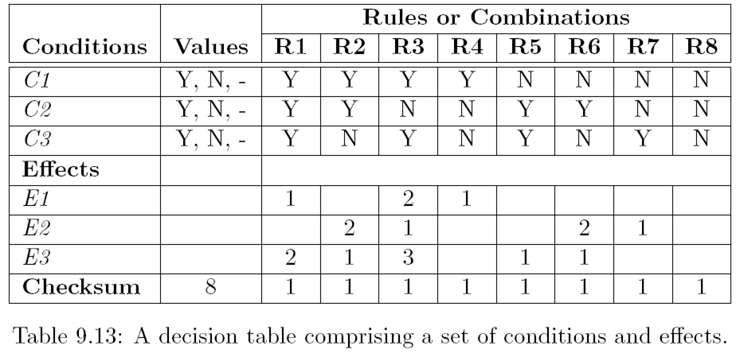
Decision Tables
Notes:
Handouts

Slide 26
Decision Tables
The steps in developing test cases using decision table technique:
Step 1: The test designer needs to identify the conditions and the effects for each specification unit.
  A condition is a distinct input condition or an equivalence class of input conditions
  An effect is an output condition. Determine the logical relationship between the conditions and the effects
Step 2: List all the conditions and effects in the form of a decision table. Write down the values the condition can take
Step 3: Calculate the number of possible combinations. It is equal to the number of different values raised to the power of the number of conditions
Notes:
Handouts

Slide 27
Decision Tables
Step 4: Fill the columns with all possible combinations – each column corresponds to one combination of values. For each row (condition) do the following:
  Determine the Repeating Factor (RF): divide the remaining number of combinations by the number of possible values for that condition
  Write RF times the first value, then RF times the next and so forth, until row is full
Step 5: Reduce combinations (rules). Find indifferent combinations - place a “-” and join column where columns are identical. While doing this, ensure that effects are the same
Step 6: Check covered combinations (rules). For each column calculate the combinations it represents. A “-” represents as many combinations as the condition has. Multiply for each “-” down the column. Add up total and compare with step 3. It should be the same
Step 7: Add effects to the column of the decision table. Read column by column and determine the effects. If more than one effect can occur in a single combinations, then assign a sequence number to the effects, thereby specifying the order in which the effects should be performed. Check the consistency of the decision table
Step 8: The columns in the decision table are transformed into test cases
Notes:
Handouts

Slide 28
Random Testing
In the random testing approach, test inputs are selected randomly from the input domain of the system
Random testing can be summarized as:
  Step 1 : The input domain is identified
  Step 2 : Test inputs are selected independently from the domain
  Step 3 : The system under test is executed on these inputs
    The inputs constitute a random test set
  Step 4 : The results are compared to the system specification.
    The test is a failure if any input leads to incorrect results
    Otherwise it is a success.
Random testing gives us an advantage of easily estimating software reliability from test outcomes
Test inputs are randomly generated according to an operational profile, and failure times are recorded
The data obtained from random testing can then be used to estimate reliability
Notes:
Handouts

Slide 29
Random Testing
Computing expected outcomes becomes difficult, if the inputs are randomly chosen
Therefore, the technique requires good test oracles to ensure the adequate evaluation of test results
A test oracle is a mechanism that verifies the correctness of program outputs
An oracle provides a method to
  generate expected results for the test inputs, and
  compare the expected results with the actual results of execution of the Implementation Under Test (IUT)
Four common types of oracles are as follows:
  Perfect oracle
  Gold standard oracle
  Parametric oracle
  Statistical oracle
Notes:
Handouts

Slide 30
Adaptive Random Testing
In adaptive random testing the test inputs are selected from the randomly generated set in such a way that these are evenly spread over the entire input domain
The goal is to select a small number of test inputs to detect the first failure
A number of random test inputs are generated, then the “best” one among them is selected
We need to make sure the selected new test input should not be too close to any of the previously selected ones
That is, try to distribute the selected test inputs as spaced out as possible
Notes:
Handouts

Slide 31
Error Guessing
It is a test case design technique where a test engineer uses his experience to
  guess the types and probable locations of defects, and
  design tests specifically to reveal the defects
Though experience is of much use in guessing errors, it is useful to add some structure to the technique
It is good to prepare a list of types of errors that can be uncovered
The error list can aid us in guessing where errors may occur. Such a list should be maintained from experience gained from earlier test projects
Notes:
Handouts

Slide 32
Category Partition
The Category Partition Method (CPM) is a systematic, specification based methodology that uses an informal functional specification to produce formal test specification
The test designer’s key job is to develop categories, which are defined to be the major characteristics of the input domain of the function under test
Each category is partitioned into equivalence classes of inputs called choices
The choices in each category must be disjoint, and together the choices in each category must cover the input domain
Notes:
Handouts

Slide 33
Category Partition
The method comprise of the following steps:
Step 1. Analyze the Specification
Step 2. Identify Categories
Step 3. Partition the Categories into Choices
Step 4. Determine Constraints among Choices
Step 5. Formalize and Evaluate the Test Specification
Step 6. Generate and Validate the Test Cases
Notes:
Handouts

